Slide 1
Misinformation Detection AI
Anish, Kenan, Baylee, Gina

Slide 2
Problem
There is a growing problem of misinformation.
Statistics can be easily manipulated to sway people to incorrect conclusions.
Media is widely untrusted (for good reason) making more and more people unaware of current issues being faced.

Slide 3
Solution
AI tool scanning news as well as popular media sources live.
Checking for bias as well as fact checking information presented.
Capable of searching multiple mediums, analyzing text, image, and audio.

Slide 4
Example Problem
A case in which misinformation would likely be widespread is a global pandemic.
Misinformation could be putting people's lives at risk in a multitude of ways.
Improper personal care measures.
Wasted resources

Slide 5
Example of AI in Use
Scanning news articles, informing users of the most accurate information available.
Reduction in mistakes, thus reducing potential lives risked.

Slide 6
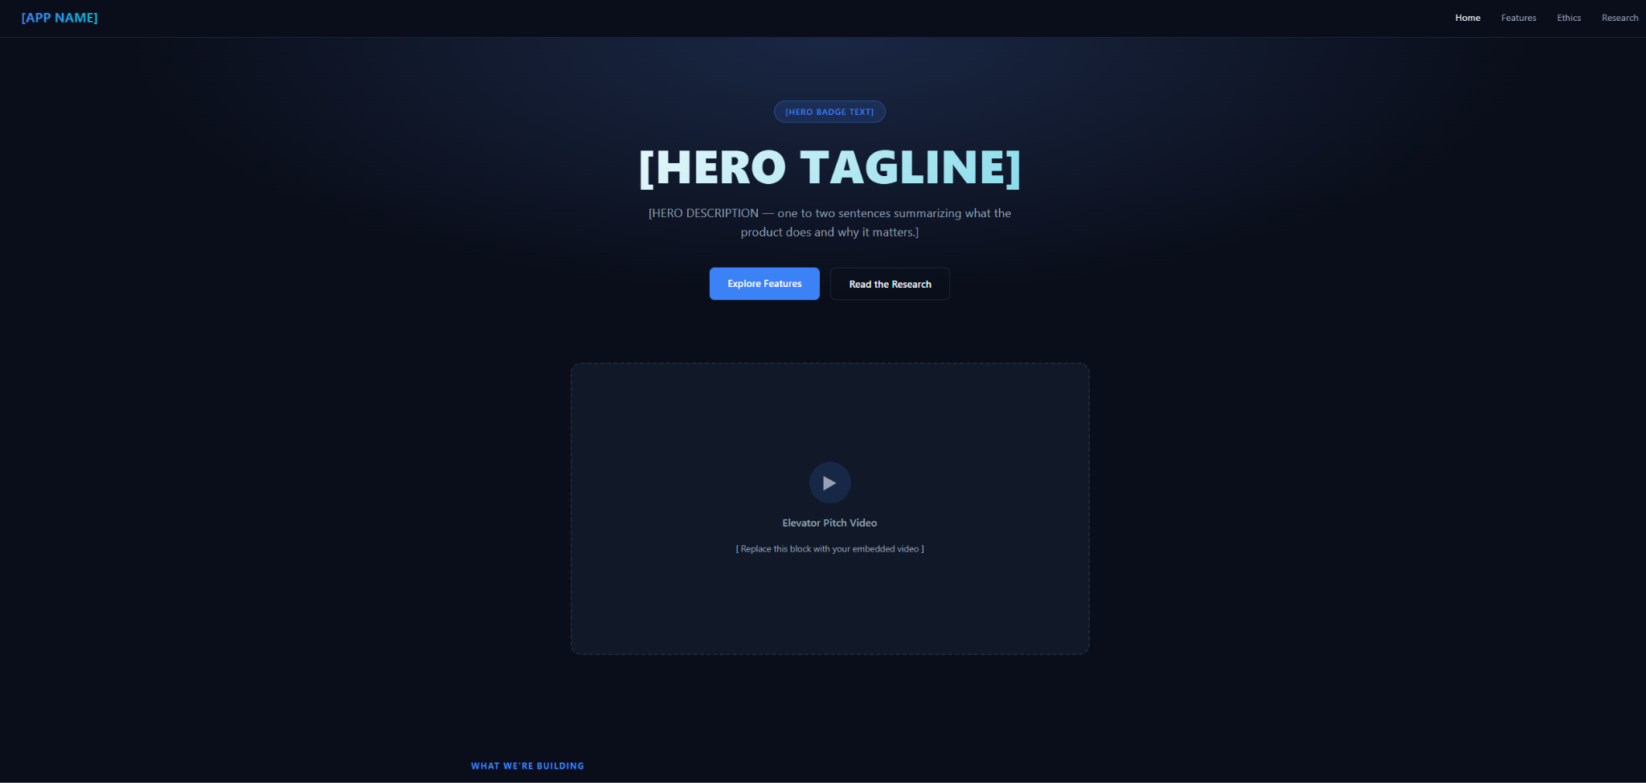
Website Outline

Slide 7
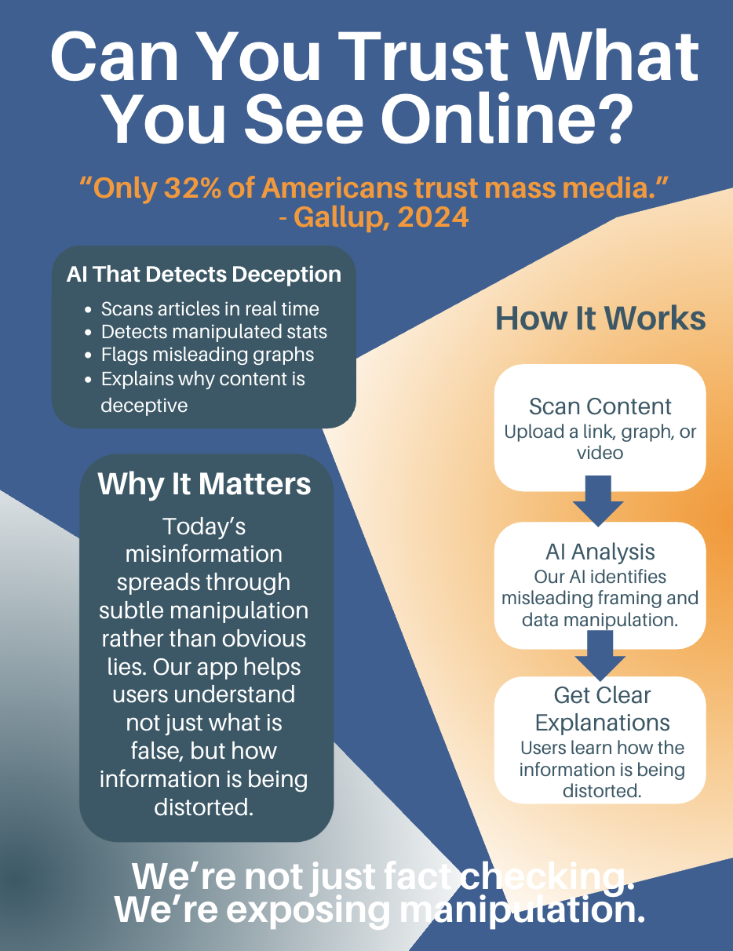
Infographic

Slide 8
Impact
According to a 2024 Gallup poll, only 32% of Americans have a “great deal” or “fair amount” of trust in mass media, which signals that people sense something is wrong but often cannot pinpoint exactly what.
Our product could allow for a vast increase in the reliability of news, allowing for a vastly more current event educated society.

Slide 9
Business
Our total addressable market is the 331 million internet users in the United States alone during 2026.
With a free, ad-supported model, even capturing just 1% of that as active users generates around 3 million dollars annually at a conservative one dollar per user.
Could be scaled to more expensive models, allowing for a sustainable business.

Slide 10
Thank you
Sources
https://reacheffect.com/blog/how-much-can-an-app-make-from-advertising/
https://www.statista.com/statistics/325645/usa-number-of-internet-users/?srsltid=AfmBOoqz7pRKXxLRxbfXGsOr5IxcblfQO-Ktrc7_NvpZIkIvMiUCwymV
https://www.statista.com/statistics/1462054/false-news-consumption-frequency-us/
https://deakin.libguides.com/misinformation/impact

